Slide 1

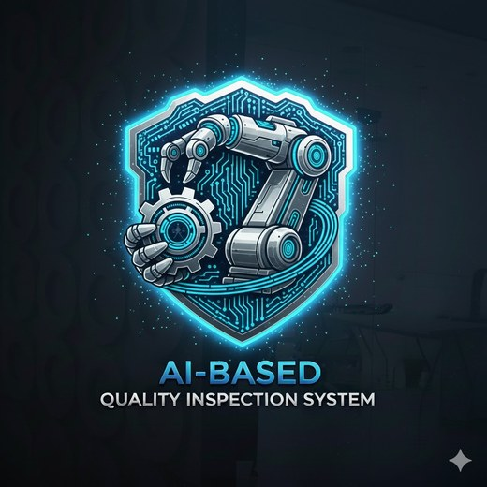
HAWK Factory
Intelligent Defect Detection in Modern Manufacturing
HAWK Factory Team · Supervised by: Dr. Sahar Kamal
Computer Science & Cybersecurity · Faculty of Engineering Technology
Graduation Project II — 2025 / 2026
El Sewedy University of Technology – SUT

Slide 2
PROJECT OVERVIEW
HAWK Factory is a deep-learning visual-inspection platform. A custom YOLOv8 model (HAWK-YOLO) detects and localises surface defects on each unit in real time, logs the result, and triggers a servo to reject faulty parts — helping manufacturers and quality-control teams.
7 Members
2 Semesters
YOLOv8 · Python
Team Size
Duration
Tech Stack
El Sewedy University of Technology · 2025 / 2026

Slide 3
TABLE OF CONTENTS
01
Team Members
05
Demo & Screenshots
Introducing the project team and supervisor
Live walkthrough of the working system
02
Problem Statement
06
Results & Evaluation
The challenge we are addressing and why it matters
Performance metrics, testing outcomes and analysis
03
Proposed Solution
07
Timeline
Our approach, key features and components
Project phases, milestones and deliverables
04
System Architecture
Technical design, methodology and tools used
El Sewedy University of Technology — 2025 / 2026

Slide 4
01
TEAM MEMBERS
1
2
3
4
Marwa Mohamed
Norhan Rafik
Doha Ramy
Alaa Adel
ID: 240102975
ID: 240102862
ID: 240102408
ID: 230105740
Team Member
Team Member
Team Member
Team Member
Computer Science
Computer Science
Computer Science
Computer Science
Supervised by: Dr. Sahar Kamal | Faculty of Engineering Technology

Slide 5
01
TEAM MEMBERS
1
2
3
Mahmoud Kamal
Mohamed Abdelrazek
Noor Hany Ragb
ID: 230105825
ID: 240102743
ID: 240101062
Team Member
Team Member
Team Member
Network & Cyber Security
Network & Cyber Security
Network & Cyber Security
Supervised by: Dr. Sahar Kamal | Faculty of Engineering Technology

Slide 6
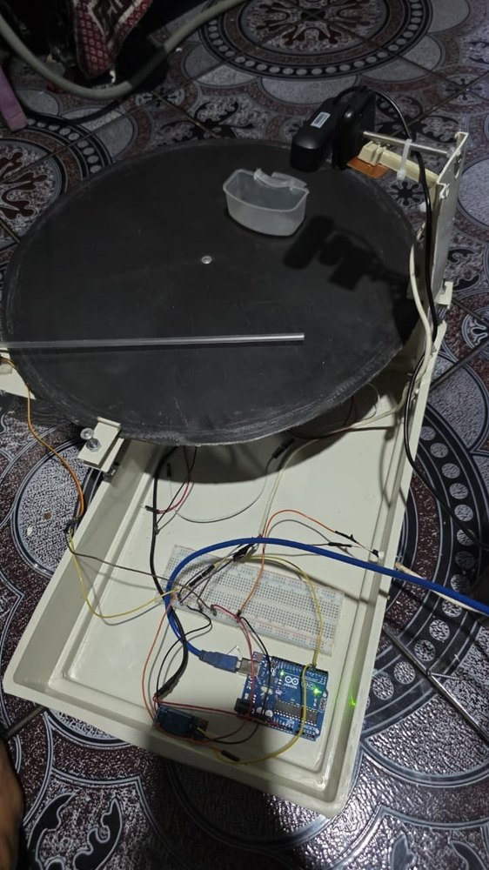
02
PROBLEM STATEMENT
THE PROBLEM
Modern lines must inspect thousands of units per hour, yet defects appear in endless forms. Manual inspection fatigues and is inconsistent, while rule-based vision is sensitive to lighting and fails silently on defects it was never tuned for.
WHY IT MATTERS
Undetected defects reach the customer — causing scrap, rework, recalls and lost trust.
Manual checking cannot keep pace with high-throughput, high-precision production.
In Industry 4.0, quality is a condition of survival, not just a competitive advantage.
1000s
Zero
24/7
Units / hour
Defect goal
Line operation

Slide 7
03
PROPOSED SOLUTION
HAWK Factory inspects every unit on the line in real time and automatically rejects the defective ones — using a custom-trained deep-learning detector on low-cost hardware.
◈
◉
◎
HAWK-YOLO Detector
Inspection Platform
Reject Station
A custom YOLOv8 model that both classifies each unit and localises its defect, at about 35 ms per image.
Multi-camera, multi-tenant app with a bilingual dashboard, a REST API and a database — usable by non-specialists.
A rotating-disc station with an overhead camera and an Arduino-driven servo that sweeps out defective parts.

Slide 8
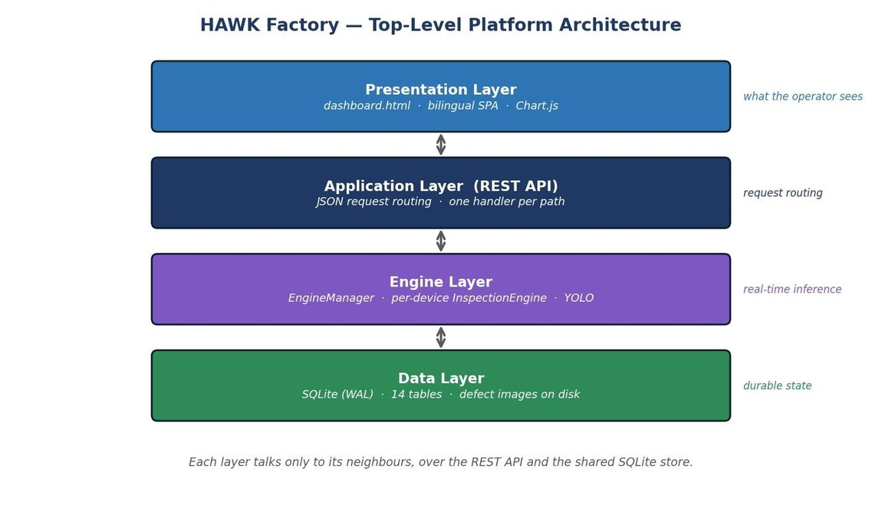
04
SYSTEM ARCHITECTURE & METHODOLOGY
1
Data Collection
Four industrial datasets (MVTec AD, NEU, DAGM 2007, KolektorSDD) plus in-house product imagery.
2
Preprocessing
Resizing, normalisation and augmentation, with transfer learning.
3
Core Model — HAWK-YOLO
Custom YOLOv8 detector, benchmarked against CNN, MobileNet and EfficientNet-B0.
4
Output & Interface
Bilingual dashboard, REST API, database log and PLC / Arduino reject.
TOOLS & TECHNOLOGIES
Python · PyTorch / YOLOv8 · OpenCV · Flask · SQLite

Slide 9
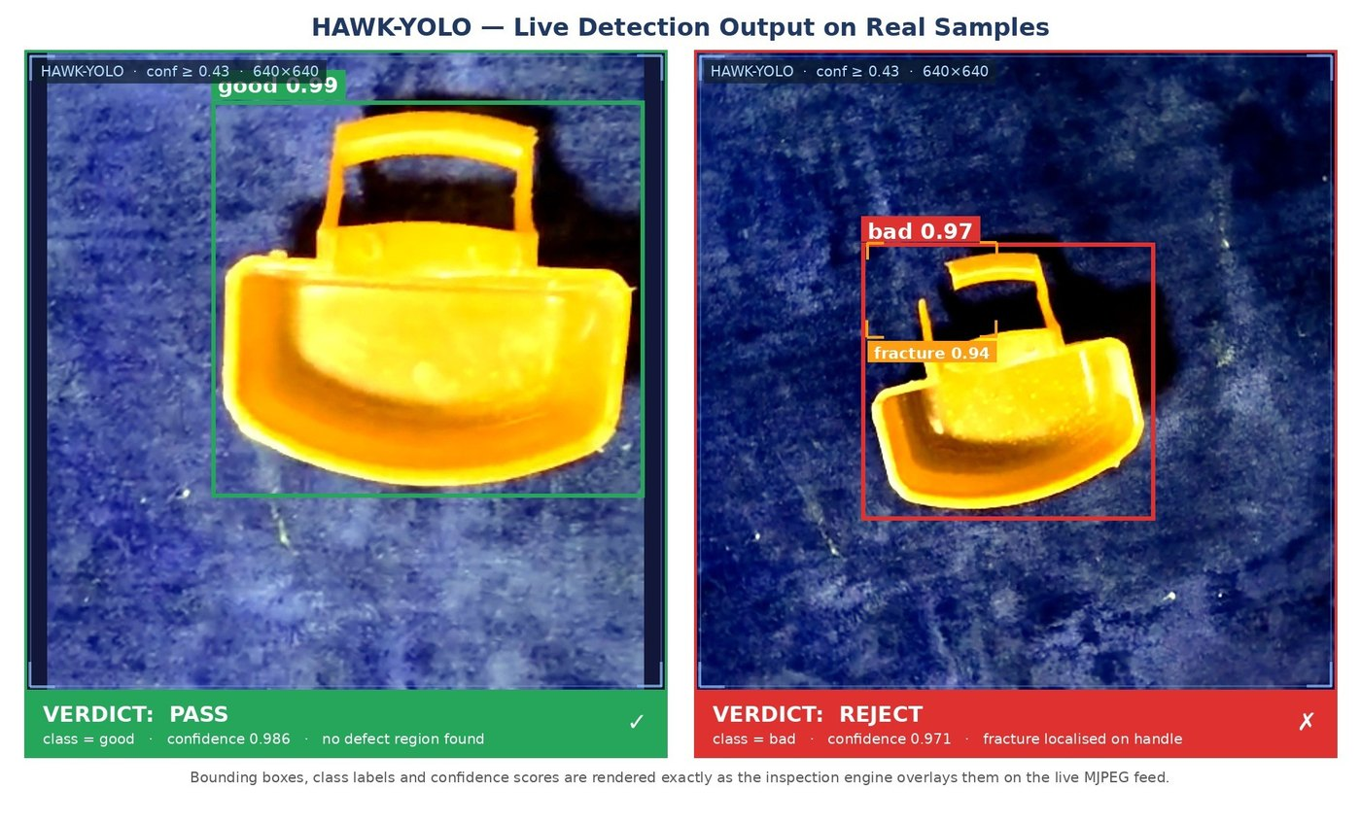
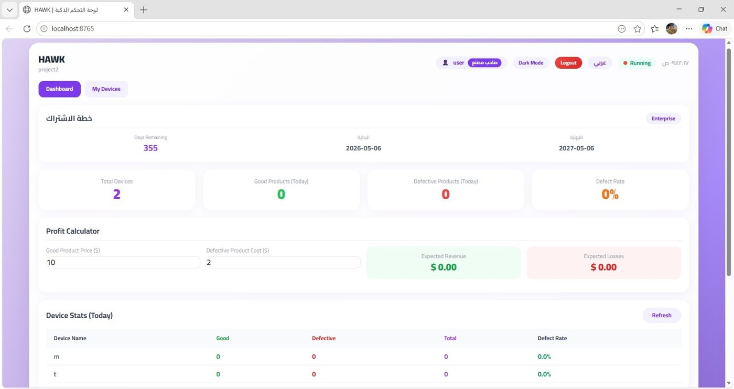
05
DEMO & SCREENSHOTS
HAWK Factory dashboard — device stats, defect rate & profit calculator
HAWK-YOLO live detection — PASS vs REJECT (fracture localised on the handle)
⬡ Live demo available during presentation

Slide 10
06
RESULTS & EVALUATION
98.9%
0.985
~35 ms
mAP@50 (HAWK-YOLO)
Precision
Inference / image

Slide 11
07
PROJECT TIMELINE
Phase 1
Phase 2
Phase 3
Phase 4
Phase 5
Research &
Requirements
Design &
Prototyping
Development
Sprint
Testing &
Evaluation
Final Report
& Demo
Wk 1–2
Wk 3–4
Wk 5–8
Wk 9–10
Wk 11–12
Requirements
Document
Design
Prototype
Working
System
Test
Report
Final
Presentation

Slide 12

Thank You
We welcome your questions
Contact: sahar.kamal@sut.edu.eg · QMS: qms.sut.edu.eg/web/projects/view/70
El Sewedy University of Technology · 2025 / 2026

